Slide 1


Sam Hoffman
7/13/23

Slide 2

Outline
Executive Summary
Introduction
Methodology
Results
Conclusion

Slide 3
Executive Summary
Summary of methodologies. All work was performed using Python with Jupyter Notebooks and the noted libraries.
Data gathering: Data was scraped using Requests and parsed using BeautifulSoup, data was also gathered using the SpaceX Rest API.
Data wrangling and cleaning: Data was cleaned for outliers, improper datatypes, and other issues using Pandas and Numpy.
Exploratory Analysis: Conducted using SQL magic commands, Pandas, & Matplotlib.
Data visualizations: Visualizations were generated using Plotly Express, Dash, Seaborn, Folium, & Matplotlib.
Machine Learning Analysis: Conducted using Logistic Regression, Decision Trees, K-Nearest Neighbors, and Support Vector Machines from the Scikitlearn library.
Summary of all results.
Several factors impact whether a flight was able to have a successful landing and recovery of the first stage.
We found that later flights have been more successful than earlier flights.
Payload appears to have little to no impact on a successful recovery of the first stage.

Slide 4
Introduction
Project background and context
The space industry has seen remarkable advancements in recent years, with private companies playing a significant role in revolutionizing space exploration. One such company at the forefront of this innovation is SpaceX, led by entrepreneur Elon Musk. SpaceX's Falcon 9 rocket has gained recognition for its groundbreaking ability to land and be reused, significantly reducing the cost of space missions.
SpaceX's Falcon 9 rocket is comprised of two stages: the first stage and the second stage. The first stage is responsible for the initial boost during launch and is designed to be reusable, while the second stage carries the payload to its intended destination. By reusing the first stage, SpaceX has successfully disrupted the traditional space industry model, where rockets were predominantly disposable, leading to astronomical costs for each launch.
Introduction
In this capstone project, our objective is to predict the landing success of the Falcon 9 first stage. By accurately determining whether the first stage will land successfully, we can estimate the cost of each launch. This information is vital for potential competitors who wish to bid against SpaceX for rocket launches, as they need to factor in the cost savings achieved through the reuse of the first stage.

Slide 5

Section 1

Slide 6
Methodology
Executive Summary
Data collection methodology:
Using SpaceX Rest API
Using web scraping from Wikipedia
Perform data wrangling
Filtering the data, dealing with missing values, employing One Hot Encoding to prepare categorical data.
Perform exploratory data analysis (EDA) using visualization and SQL
Perform interactive visual analytics using Folium and Plotly Dash
Perform predictive analysis using classification models
How to build, tune, evaluate classification models

Slide 7
Data Collection
The data collection process involved using API requests from SpaceX’s REST API and web scraping applicable data found here
Data needed to be gathered using both methods to create a complete dataset.

Slide 8
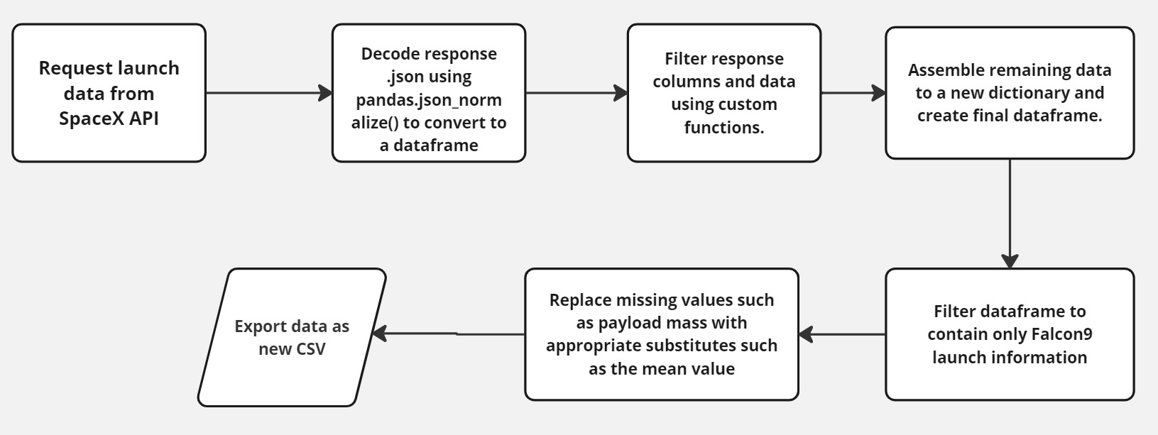
Data Collection – SpaceX API
Notebook found here: https://github.com/hoffman1sr/IBMCapstoneProject/blob/main/jupyter-labs-spacex-data-collection-api%20(1).ipynb

Slide 9
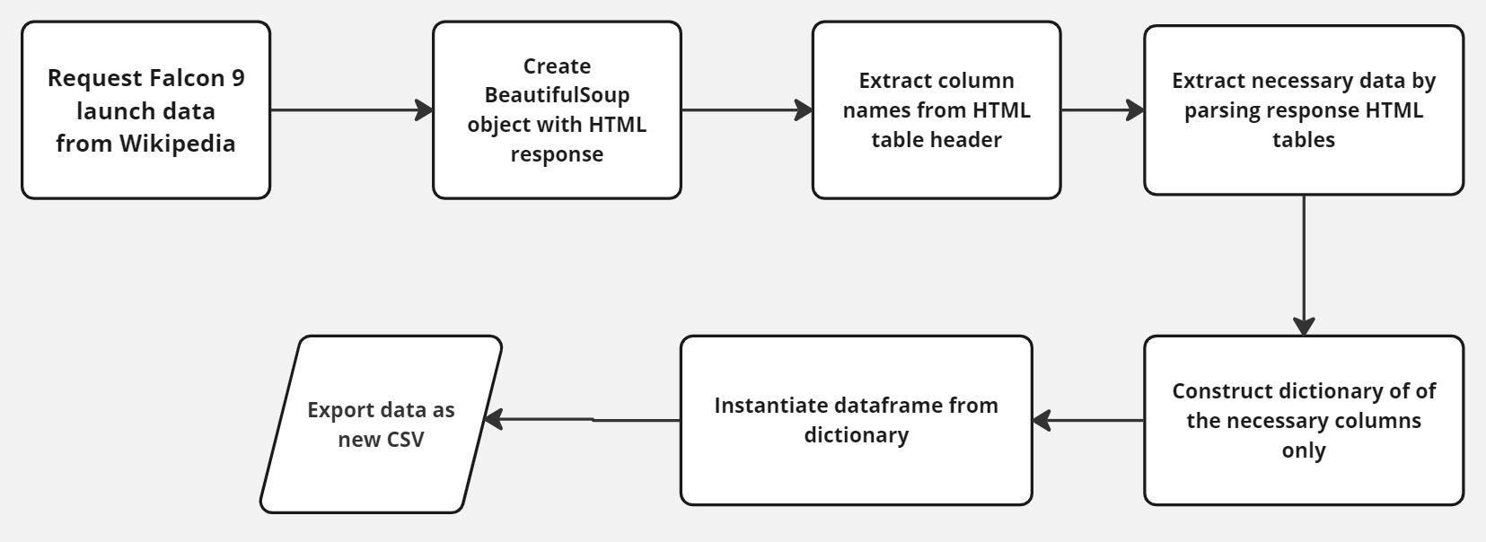
Data Collection - Scraping
Notebook found here: https://github.com/hoffman1sr/IBMCapstoneProject/blob/main/jupyter-labs-webscraping.ipynb

Slide 10
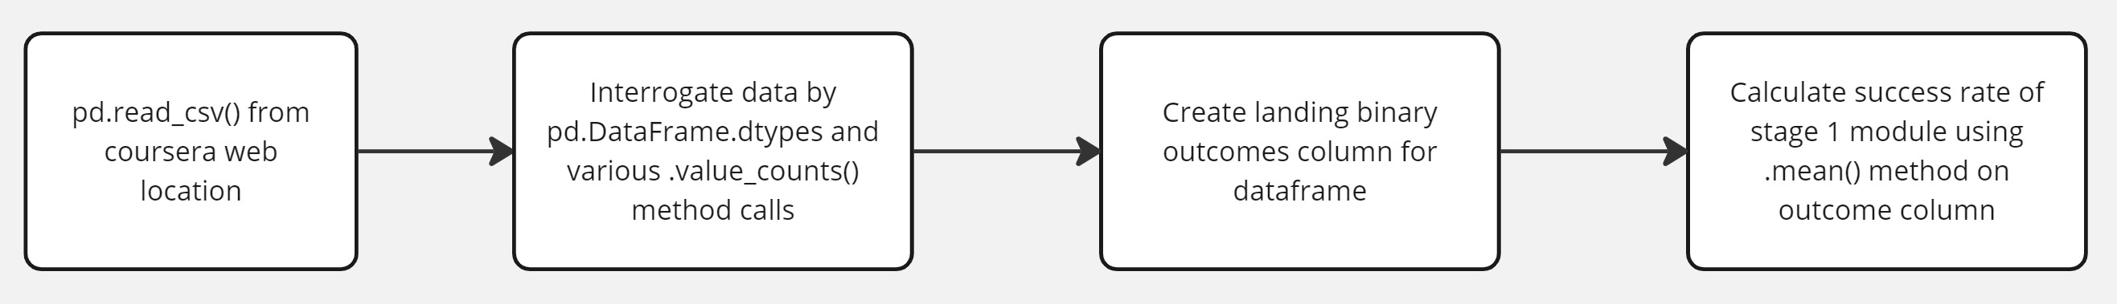
Data Wrangling
Some initial exploratory data analysis (EDA) was performed to find things like:
Number of launches from the different sites
number of successful landings based on orbit types
Success rate of landing types
Notebook found here: https://github.com/hoffman1sr/IBMCapstoneProject/blob/main/labs-jupyter-spacex-data_wrangling_jupyterlite.jupyterlite.ipynb

Slide 11
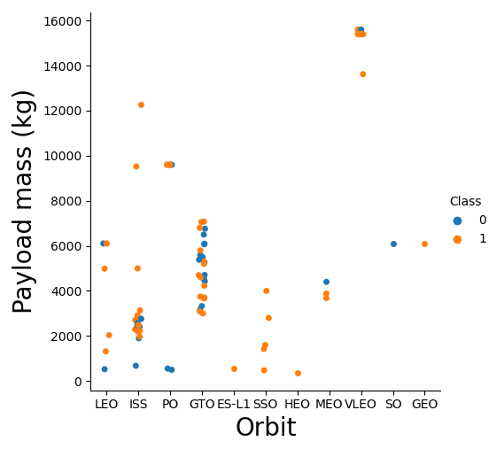
EDA with Data Visualization
Several plots were created during EDA. The plots created to investigate and visualize the relationships between 3 key flight factors:
Flight number (first flight, second flight, … nth flights)
Payload mass (kg)
Achieved orbit
Notebook here:
https://github.com/hoffman1sr/IBMCapstoneProject/blob/main/jupyter-labs-eda-dataviz.ipynb.jupyterlite.ipynb

Slide 12
EDA with SQL
Several SQL queries were performed for further EDA, including:
Individual launch sites
Total aggregated and average payload mass launched by key characteristics
Ranking landing outcomes by number of occurrences as shown here:
%sql select Landing_Outcome, count(*) as counts from SPACEXTBL where DATE BETWEEN '04-06-2010' AND '20-03-2017’ group by Landing_Outcome order by counts desc;
Notebook available here:
https://github.com/hoffman1sr/IBMCapstoneProject/blob/main/jupyter-labs-eda-sql-coursera_sqllite.ipynb

Slide 13
Build an Interactive Map with Folium
Folium was used for geospatial visualization.
Markers, circles, polylines, and clusters were all used to mark points of interest.
Markers were used to indicate point locations like launch sites.
Clusters were used to indicate groups of events like the multiple launches which may occur from a single site over time.
Polylines were used for calculating and approximating rough distances visually to key sites like the ocean, roadways, and railways.
Notebook here:
https://github.com/hoffman1sr/IBMCapstoneProject/blob/main/lab_jupyter_launch_site_location.jupyterlite.ipynb

Slide 14
Build a Dashboard with Plotly Dash
A Plotly Dash dashboard was created to explore and present results. Two main plots were used:
A pie chart with a drop down menu to select launch locations. The chart displays the proportion of launches which were either successful landings (class = 1) or not by each launch location.
A scatter plot which allows us to visualize the relationship between successful landings, payload mass, and booster version. The mass displayed can be modified using a slider above the plot.
Add the GitHub URL of your completed Plotly Dash lab, as an external reference and peer-review purpose

Slide 15
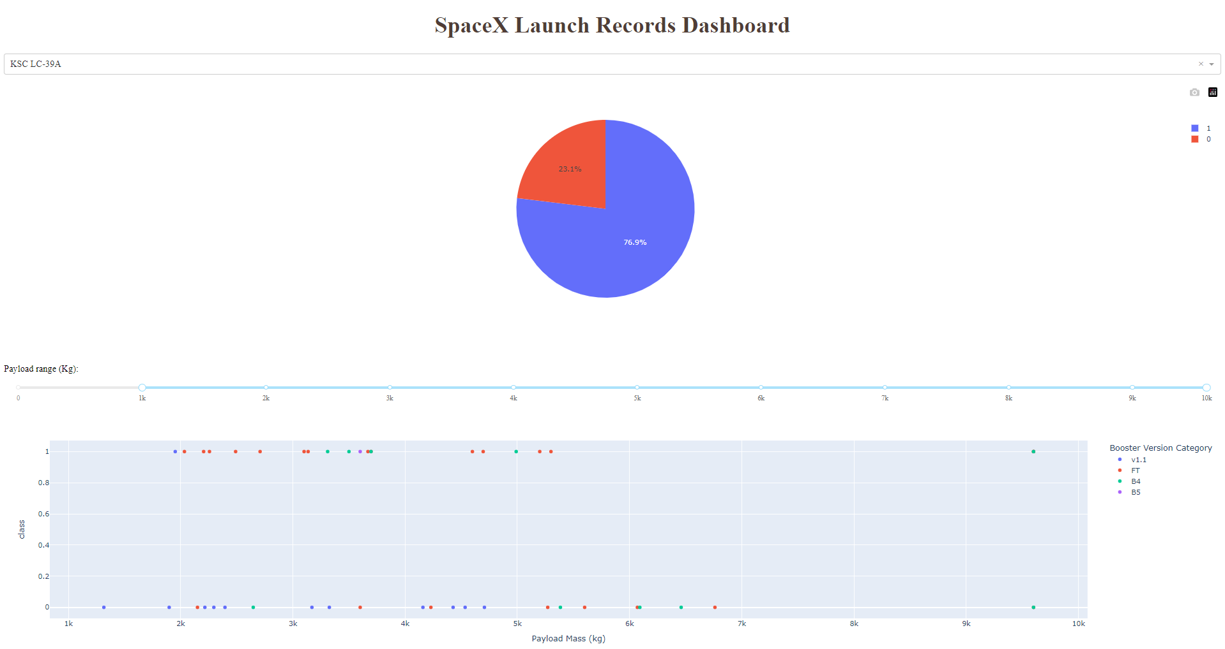
Build a Dashboard with Plotly Dash

Slide 16
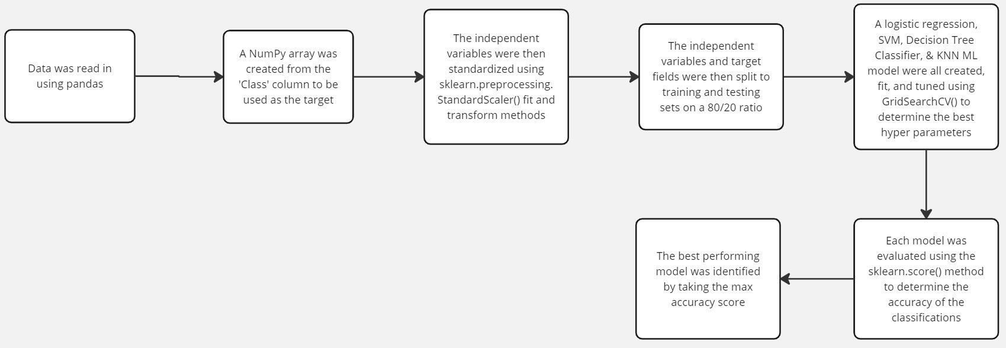
Predictive Analysis (Classification)
Several ML classification models were built and tested to determine how to best accurately predict successful landing outcomes on the data.
Notebook available here: https://github.com/hoffman1sr/IBMCapstoneProject/blob/main/SpaceX_Machine_Learning_Prediction_Part_5.jupyterlite.ipynb

Slide 17
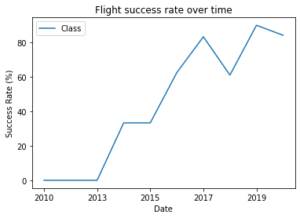
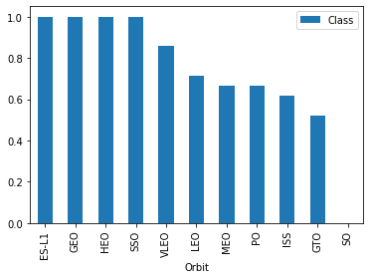
Results
Several results presented during exploratory data analysis:
Space X has used a total of three unique launch sites
Payload mass on flights with the Falcon 9 booster has ranged from 350 to 15,600 kg
There is a negative correlation between the payload mass and the likelihood of the first stage to return
Flight success rate has increased over time
ES-L1, GEO, HEO, & SSO orbits have a 100% success rate

Slide 18
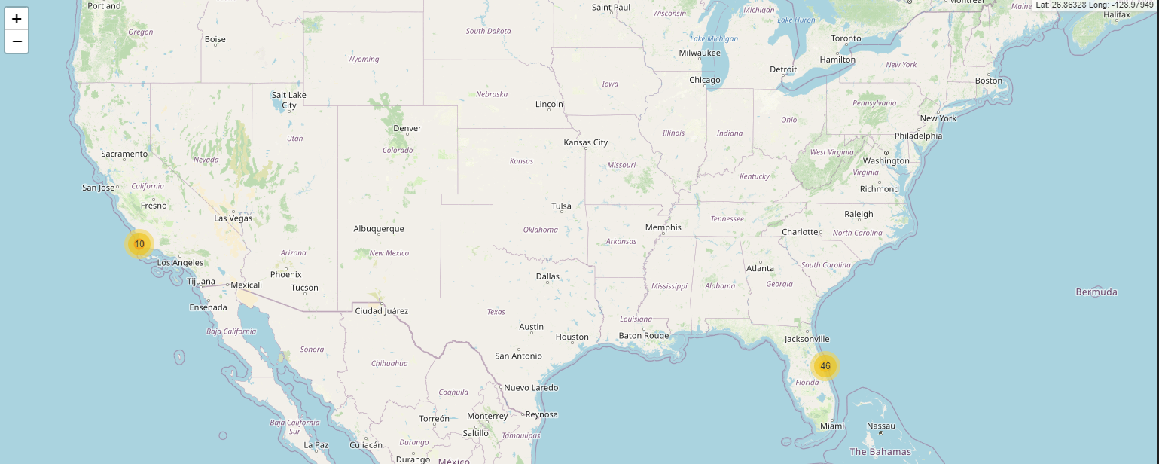
Results
Flights were launched from the states of Florida & California.
Majority of flights (46) were launched in Florida across 3 sites, with only 10 in California.
All flights were near the coast.

Slide 19

Section 2

Slide 20
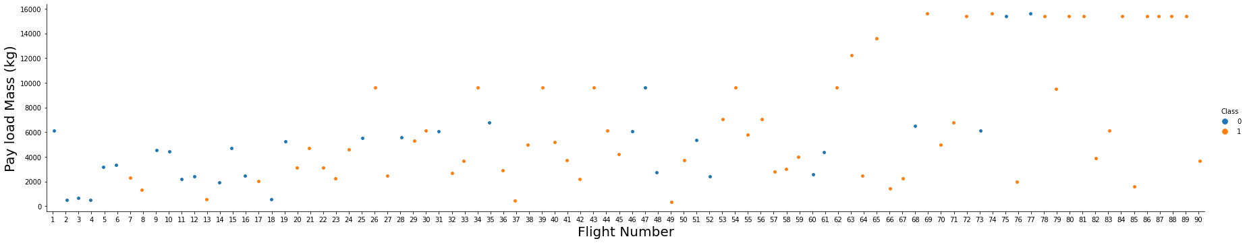
Flight Number vs. Launch Site
The figure here displays a scatter plot of flight number vs Payload. A few interesting things to note here:
There is a positive correlation between mass and flight number over time
First stage landings have become more successful (Class 1) over time

Slide 21
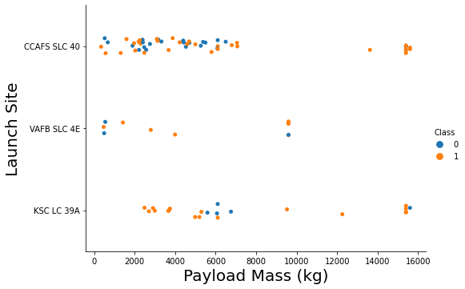
Payload vs. Launch Site
There does not appear to be any strong correlation between launch site and successful stage 1 landings.
However, it can be observed that more massive launches do not take place at the VAFB SLC 4E launch site.

Slide 22

Success Rate vs. Orbit Type
There are 4 orbit types which SpaceX has had a 100% first stage landing success rate with:
ES-L1
GEO
HEO
SSO
The SO orbit has not had a successful landing, though there have only been 4 flights to the SO orbit.

Slide 23
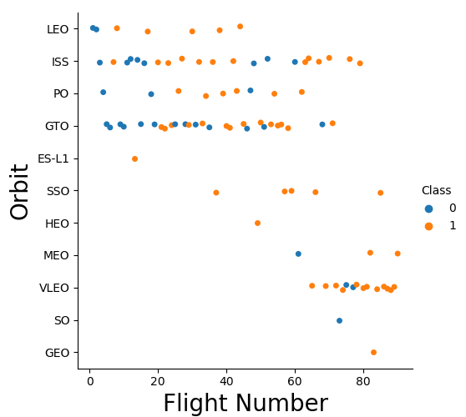
Flight Number vs. Orbit Type
Most flights, especially earlier flights have been to: LEO, ISS, PO, & GTO orbits.
It is difficult to say if the high success rates of SSO, ES-L1, HEO, and GEO orbits noted on the last slide are related to the orbit, or being later flight numbers which have higher success rates.

Slide 24
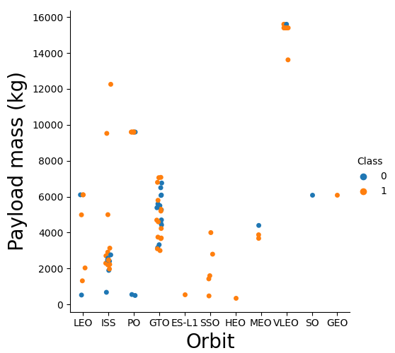
Payload vs. Orbit Type
SO, Polar, LEO, and ISS Orbits have been more successful with heavier payloads.
For GTO, payload seems to have no / little correlation between payload and landing success.

Slide 25
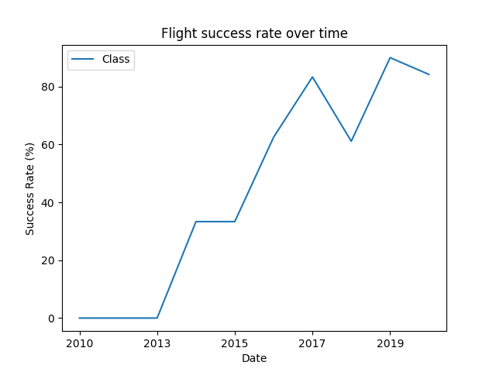
Launch Success Yearly Trend
Success rates of each flight has increased over time.
Notably there was not a successful Falcon 9 first stage landing from 2010 – 2013.
Rate increased steadily with some variation from 2013-2020.

Slide 26
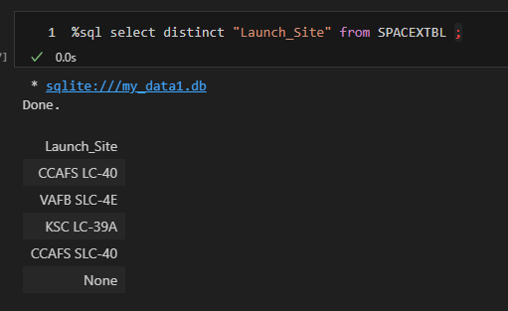
All Launch Site Names
4 total launch sites were used.
SQL EDA code shown here. All query’s performed using SQL magic commands within a Jupyter notebook environment.

Slide 27
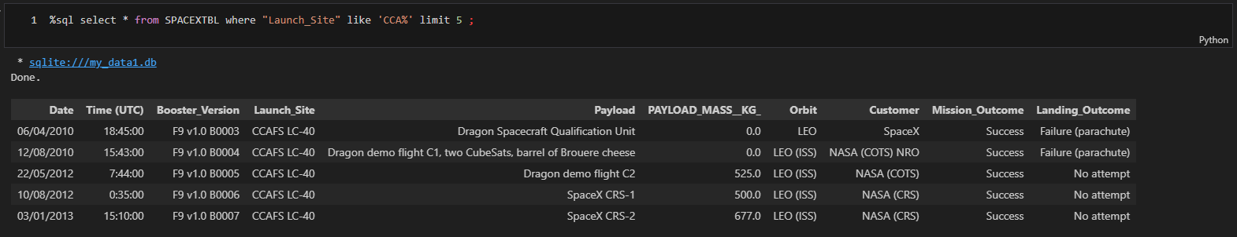
Launch Site Names Begin with 'CCA'
The first 5 flights from either CCAFS – LC40 or CCAFS – SLC40 occurred from the LC-40 site.
Query shown below.

Slide 28
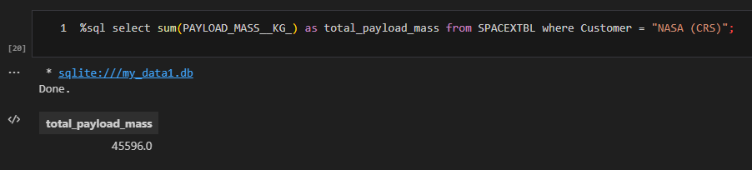
Total Payload Mass
A total payload mass of 45,596 kgs have been carried for NASA specific flights.
Sum() is used to aggregate the data identified using the where clause.

Slide 29
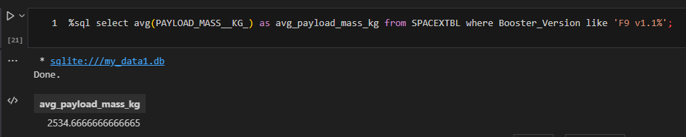
Average Payload Mass by F9 v1.1
The Falcon9 v1.1 booster had an average payload mass of approximately 2535 kg / flight.
‘Like’ is applied with a wild card to identify all booster version names which start with “F9 v1.1” regardless of following string characters.

Slide 30
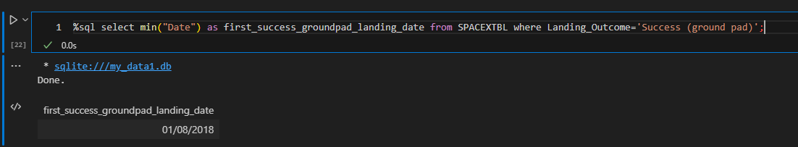
First Successful Ground Landing Date
The first successful SpaceX ground pad landing occurred on January 8th, 2018
Min() function used to identify the earliest date identified within the data matching the where clause filter of successful ground pad landings.

Slide 31
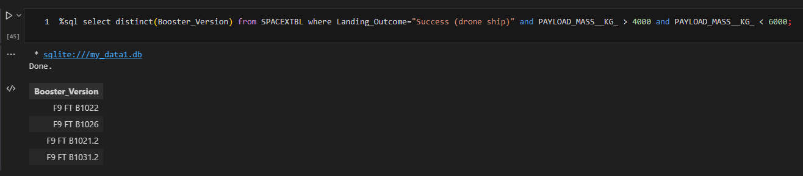
Successful Drone Ship Landing with Payload between 4000 and 6000
4 boosters have had successful drone ship landings with a payload mass of:
4000kg < payload mass < 6000kg
Distinct() used to identify only the booster names which have had successful drone ship landings and meet the pay load mass requirements.

Slide 32
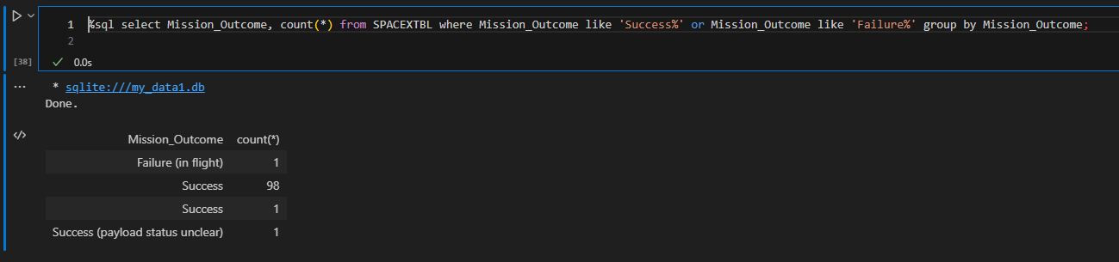
Total Number of Successful and Failure Mission Outcomes
SpaceX experienced only 1 failed mission, while there were 100 successful mission outcomes.
A wild card % character is used with an or operator to identify all outcomes starting with either “Success” or “Failure”.

Slide 33
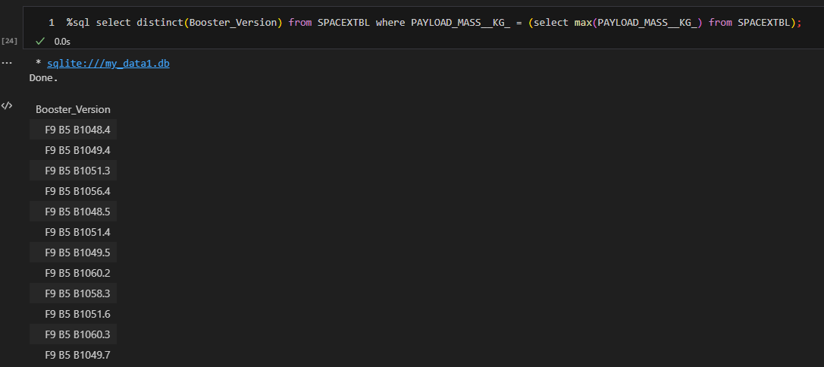
Boosters Carried Maximum Payload
12 boosters have carried the max payload of ~2535 kg. They are listed below.
A subquery is used to first identify the max payload value. This is then used in the parent where clause.

Slide 34
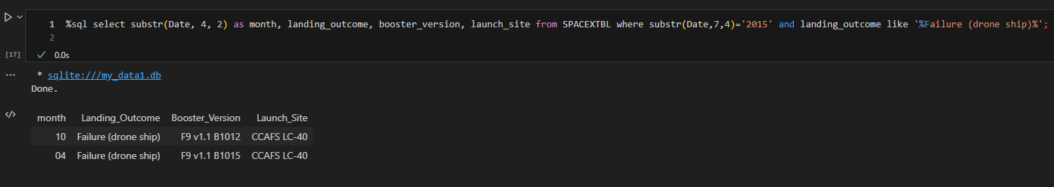
2015 Launch Records
There were two failed landing outcomes in 2015. The month, booster, and launch site for each are listed below.
SQLite substr(string, start, length) function was used for parsing str formatted dates as SQLite does not support month names.
SQLite is 1 indexed. As a result, substr(‘Hello World’, 1, 5) = “Hello” rather than “ello “.

Slide 35
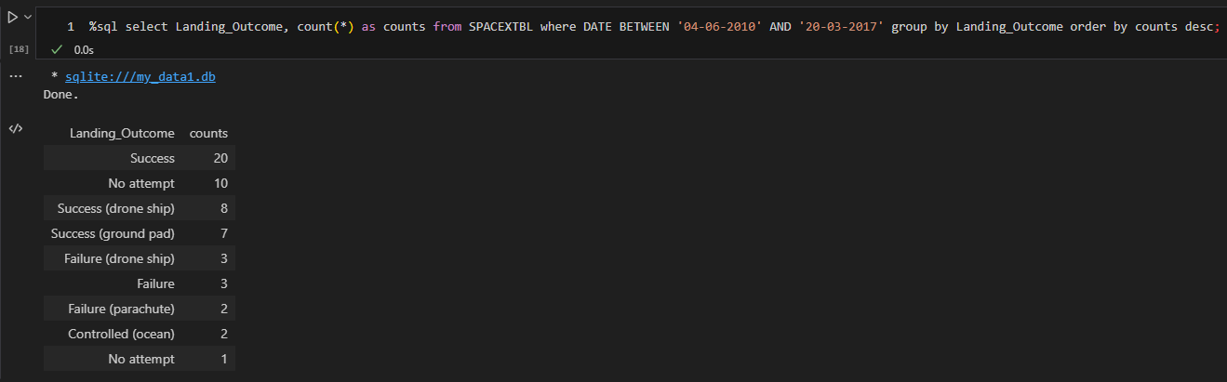
Rank Landing Outcomes Between 2010-06-04 and 2017-03-20
The ranked count of landing outcomes (such as Failure (drone ship) or Success (ground pad)) between the date 2010-06-04 and 2017-03-20, in descending order are listed below.
Group by and order by counts used to organize the query results fitting the target date range.

Slide 36

Section 3

Slide 37
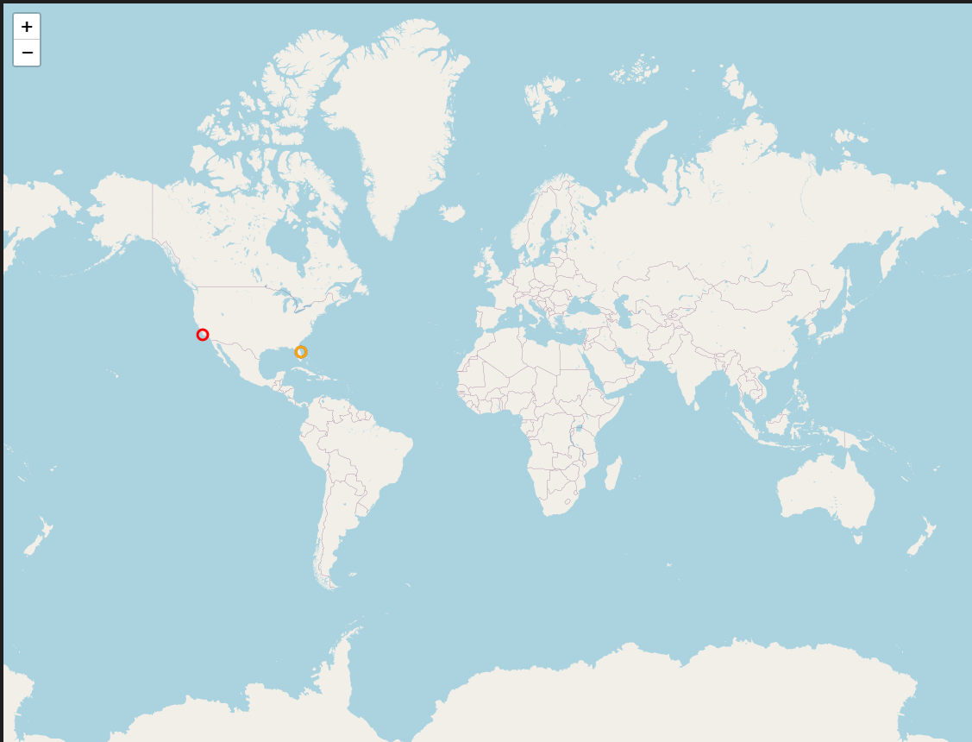
Global Launch Sites
All SpaceX launches occurred near American coast lines.
Specifically, the launches occurred in Florida and California.

Slide 38
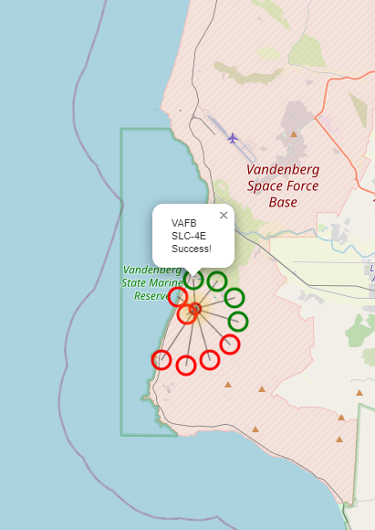
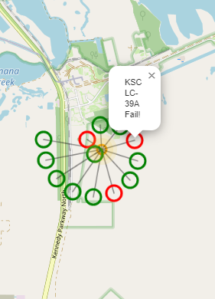
Launch Success by Location
VAFB SLC-4E (California)
KSC LC-39A (Florida)
Successful launches marked in green.
Failed launches marked in red.

Slide 39
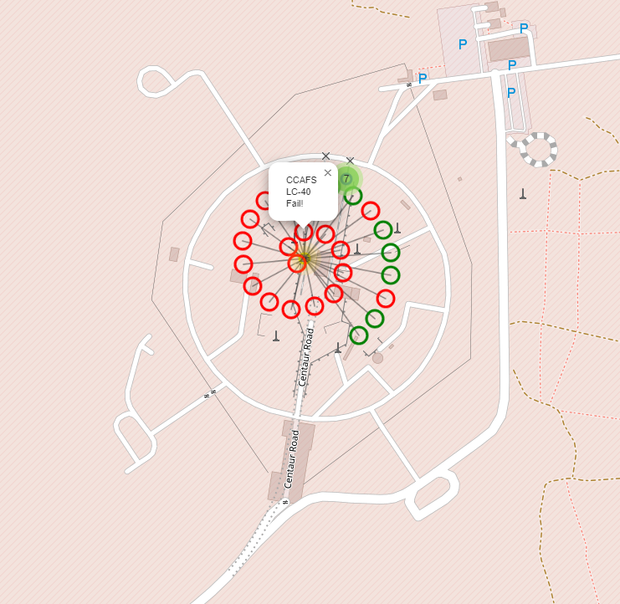
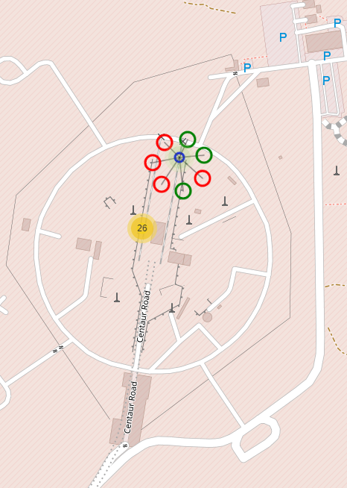
Launch Success by Location
CCAFS LC-40 (Florida)
CCAFS SLC-40 (Florida)
Successful launches marked in green.
Failed launches marked in red.

Slide 40
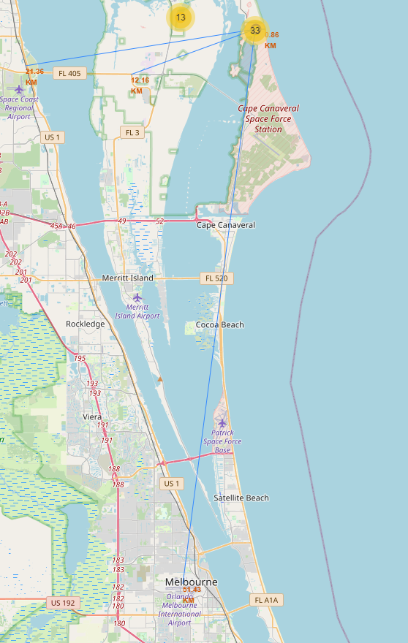
Proximity to Infrastructure
Launch Sites are strategically placed to maximize the distance between the site and key infrastructure like highways, railroads, and cities.
The distance to water, where crafts could presumably safely crash land is minimized. See the distances to the right.
The nearest major infrastructure is highway FL 405, roughly 12 kilometers away.

Slide 41

Section 4

Slide 42
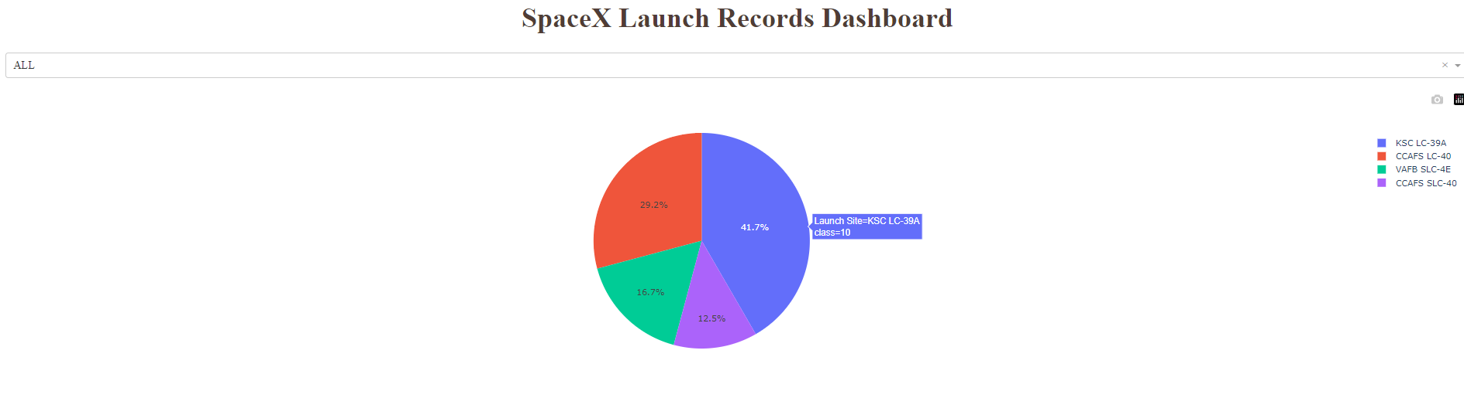
Successful Launches by Site
The most successful launches by all sites occurred from KSC LC-39A with a total of 10 successes. This accounts for ~42% of all successes.

Slide 43
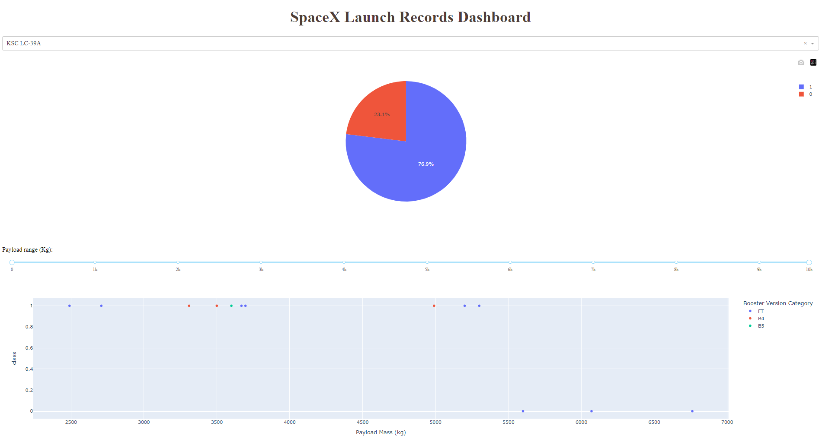
KSC LC-39A Success Rate
The launch site KSC LC-39A has had the highest flight success rate, at ~77% successful flights.
The only failures have come with payloads over 5500 kg.

Slide 44
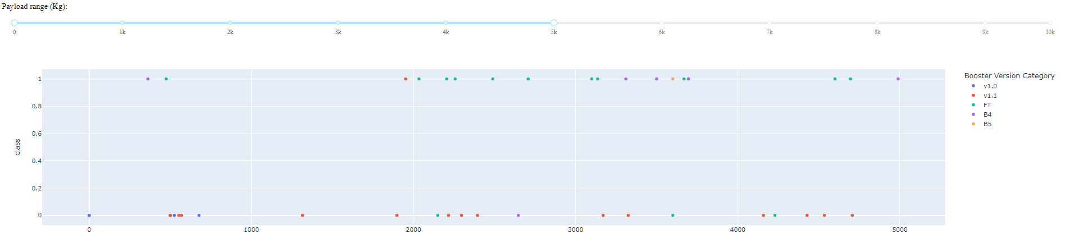
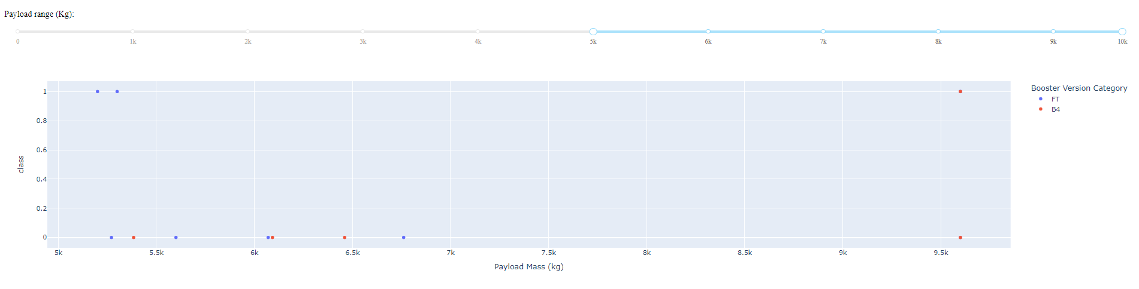
Success by Booster and Payload
There have been many more flights with payload < 5k kg. This payload range has had a higher success rate.
The FT booster looks to be the most successful of all boosters.

Slide 45

Section 5

Slide 46
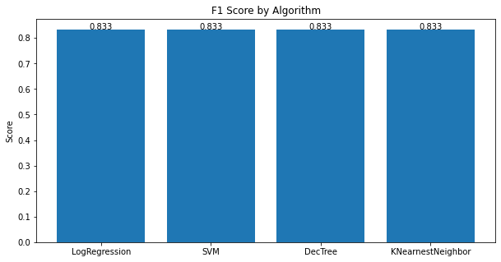
Classification Accuracy
Model accuracy is similar regardless of the method used for classification.
This may be explained by such a small dataset n=90.
It would be recommended to use K Nearest Neighbor due to being non-parametric which may lead to less overfitting.

Slide 47
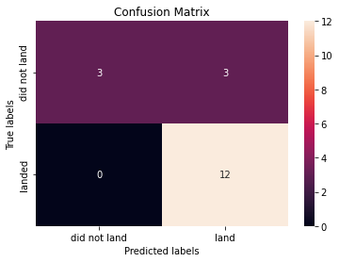
Confusion Matrix
Each algorithm produced the same confusion matrix shown right.
The biggest area for improvement with the predictions is eliminating false positives (flights which were predicted to land but did not, highlighted in red).
The model predicted 15 successful landings while only 12 true successful landings exist in the test data.

Slide 48
Conclusions
SpaceX flight success has increased over time.
Rate increased as a trend from 2013 until the end of the data in 2020.
KSC LC-39A has been the most successful SpaceX launch site.
Payload mass has increased over time as SpaceX has become more experienced.
There has not been an unsuccessful flight to ES-L1, GEO, HEO, or SSO orbits.
It would be recommended to use K Nearest Neighbors to build the classification model.

Slide 49


